Slide 1


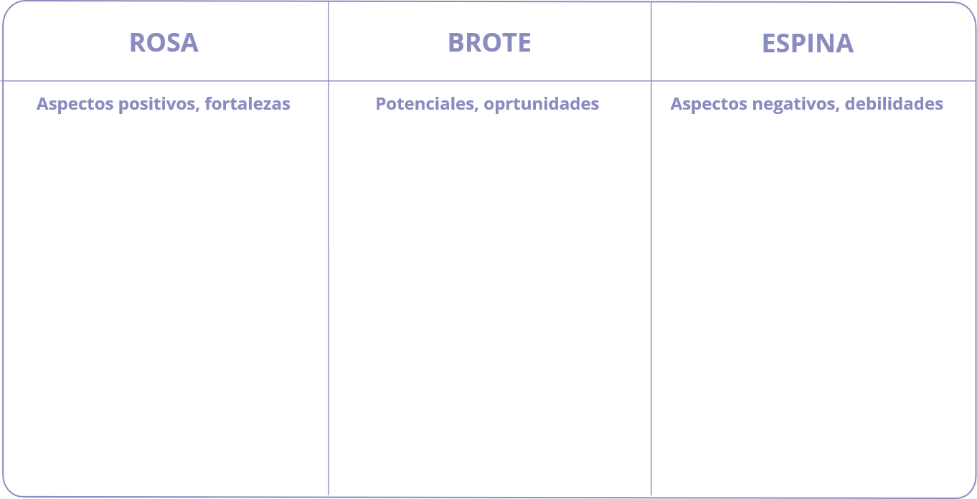

ROSA, BROTE, ESPINA
TESTEA

